Slide 1

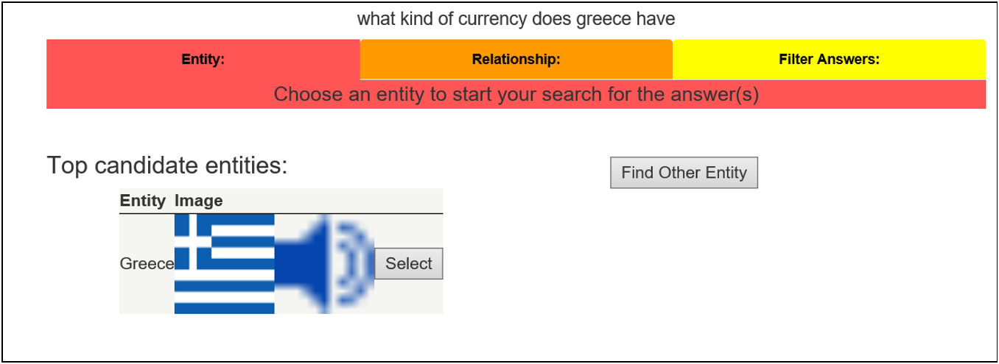
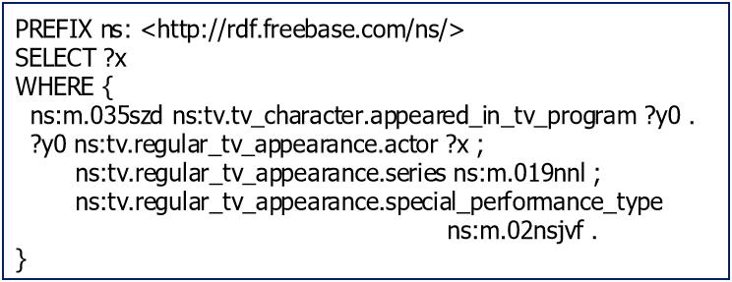
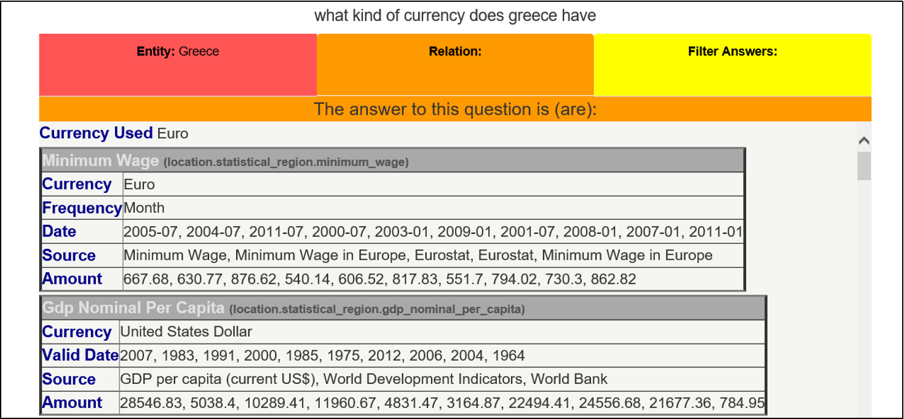
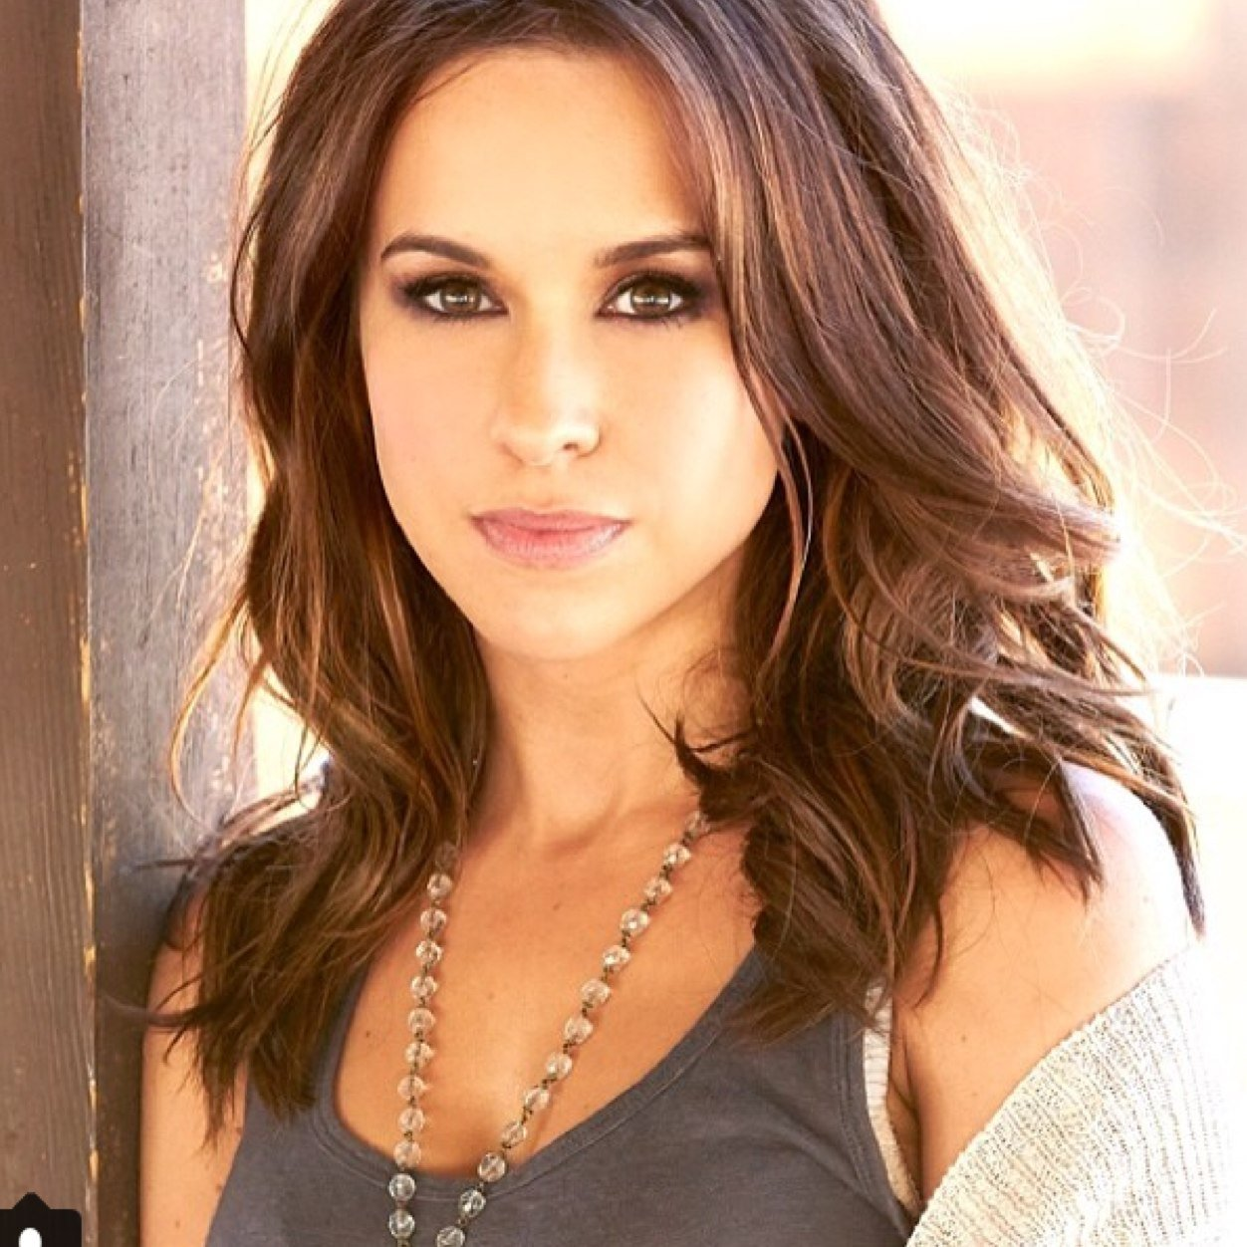

The Value of Semantic Parse Labeling for Knowledge Base Question Answering Scott Wen-tau Yih, Matthew Richardson, Christopher Meek, Ming-Wei Chang & Jina Suh Microsoft Research
http://aka.ms/WebQSP : A New WebQuestions Dataset with Full Semantic Parses
ABSTRACT
CONTRIBUTIONS
Background
A semantic parser is often trained using indirect supervision (e.g., question/answer pairs) due to the relatively low annotation cost
Research questions
Is it really that difficult/expensive to collect labeled parses? Not Really
Do labeled parses result in more accurate models? Yes!
New Dataset
WebQuestionsSP – 4,737 questions with full semantic parses
Directly executable SPARQL queries + rich semantic annotations
Designed a dialog-like labeling UI
Relabeled WebQuestions with full parses & answers
Findings
Given a good UI, the cost of labeling full parses is comparable to labeling answers
Our model is more accurate when leveraging the full parses in training
TAB UI
ASSUMPTION BEHIND “ANSWER-ONLY” LABELS
Question: What kind of currency does Greece have?
Collecting semantic labels can be a “difficult, time consuming task” [Clarke et al., 2010]
Plus, comparable performance can be achieved with labeled answers only [Liang et al., 2013]
Question: Who voiced Meg on Family Guy?
Parse:
Answer:
Lacey Chabert
Mila Kunis
DOES THE ASSUMPTION REALLY HOLD?
For some questions, it is easier to label the parse
Question: What songs did Bob Dylan write?
Parse:
Answer:
PREFIX ns: <http://rdf.freebase.com/ns/>
SELECT ?x
WHERE {
ns:m.01vrncs ns:music.composer.compositions ?x .
}
Abandoned Love
Boots of Spanish Leather
Bunkhouse Theme
Bye and Bye
Can't Leave Her Behind
Don't Fall Apart on Me Tonight
…
RESULTS
BENEFITS OF HAVING LABELED PARSES
Labeling Cost Analysis
STAGG [Yih et al. ACL-15] on WebQuestionsSP
Labeling Methods | Answers | Answers | Semantic Parses
Annotator | MTurkers | Experts | Experts
Avg Time/Question | N/A | 82 sec. | 21 sec.
Label correctness | 66% | 92% | 94%
Verified Answers
The correctness of the answers should be higher
Labeled “answers” in previous studies are derived from parses
Invariant to KB changes
When the KB is updated with new facts/events, the answers need to be updated, not the parses
More accurate models
Training Signals | Prec. | Rec. | F1
Answers | 67.3 | 73.1 | 66.8
Semantic Parses | 70.9 | 80.3 | 71.7

